Slide 1
CSL7090 Software & Data Engineering
Lecture #7 Availability and Failure, Availability tactics
Course Instructors:
Sumit Kalra, Assistant Professor, IIT Jodhpur
Ram Subramaniam, Co-founder - My Money Karma

Slide 2
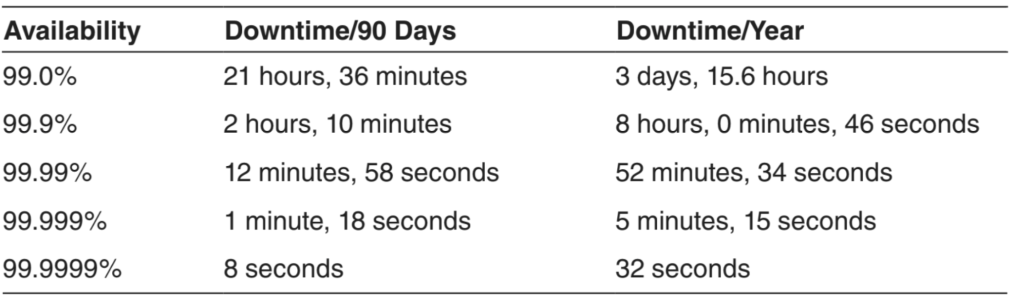
Availability in numbers . . .

Slide 3
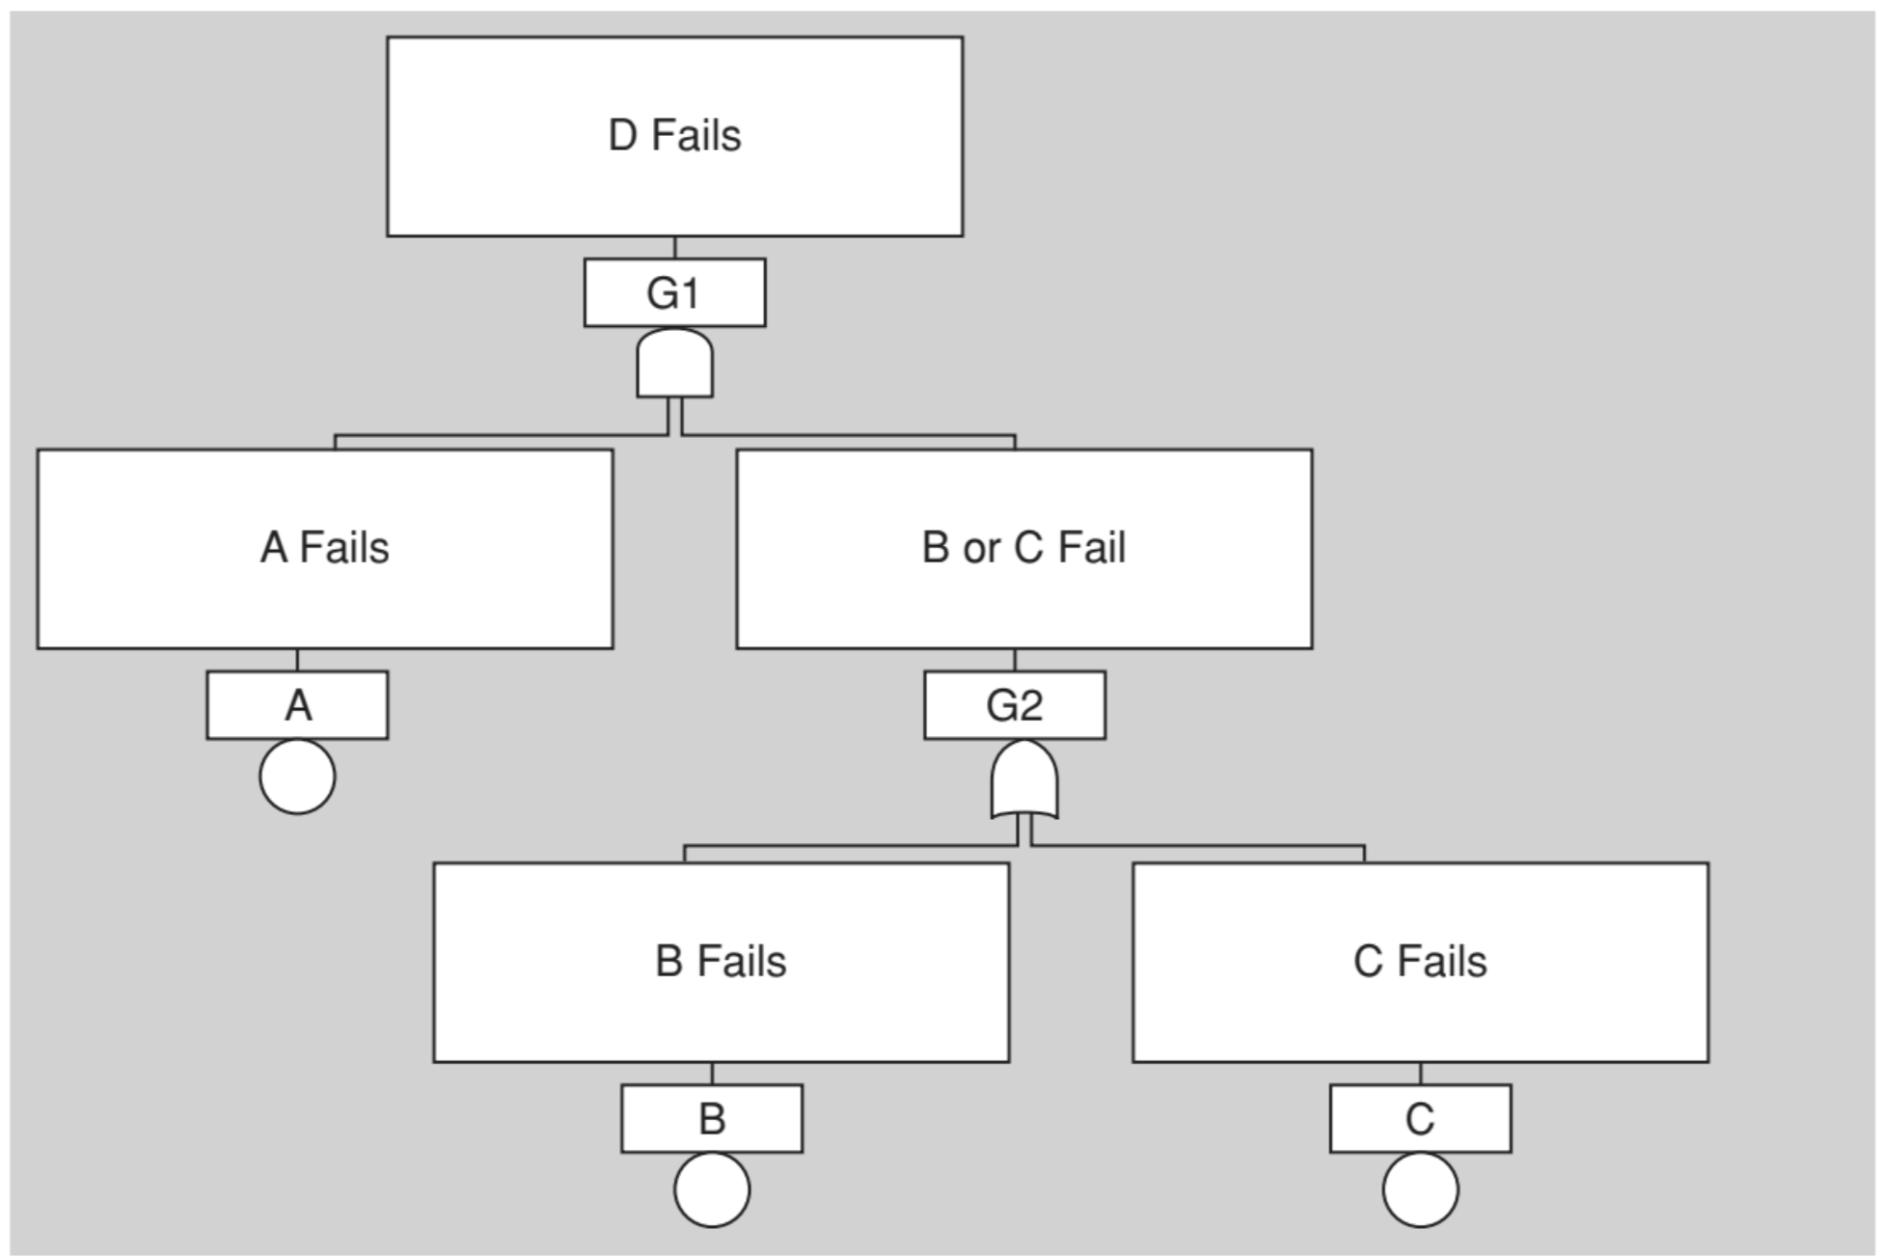
Example of a fault tree

Slide 4
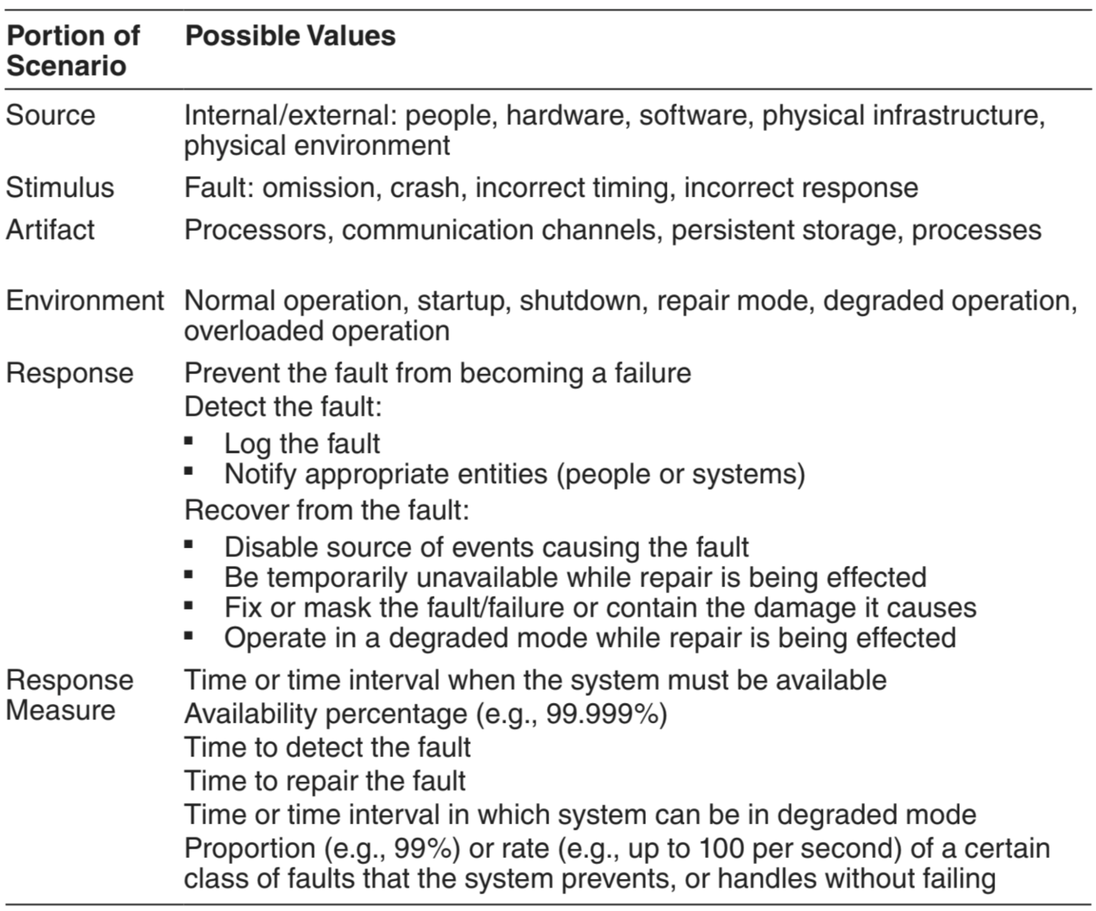
Availability General Scenario
Source
Stimulus
Artifact
Environment
Response
Response Measure

Slide 5
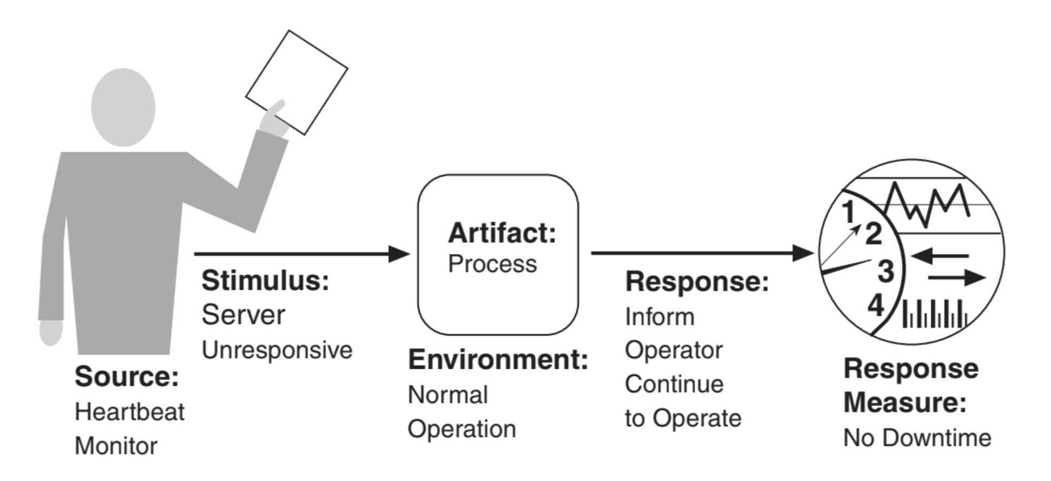
Availability Concrete Scenario

Slide 6
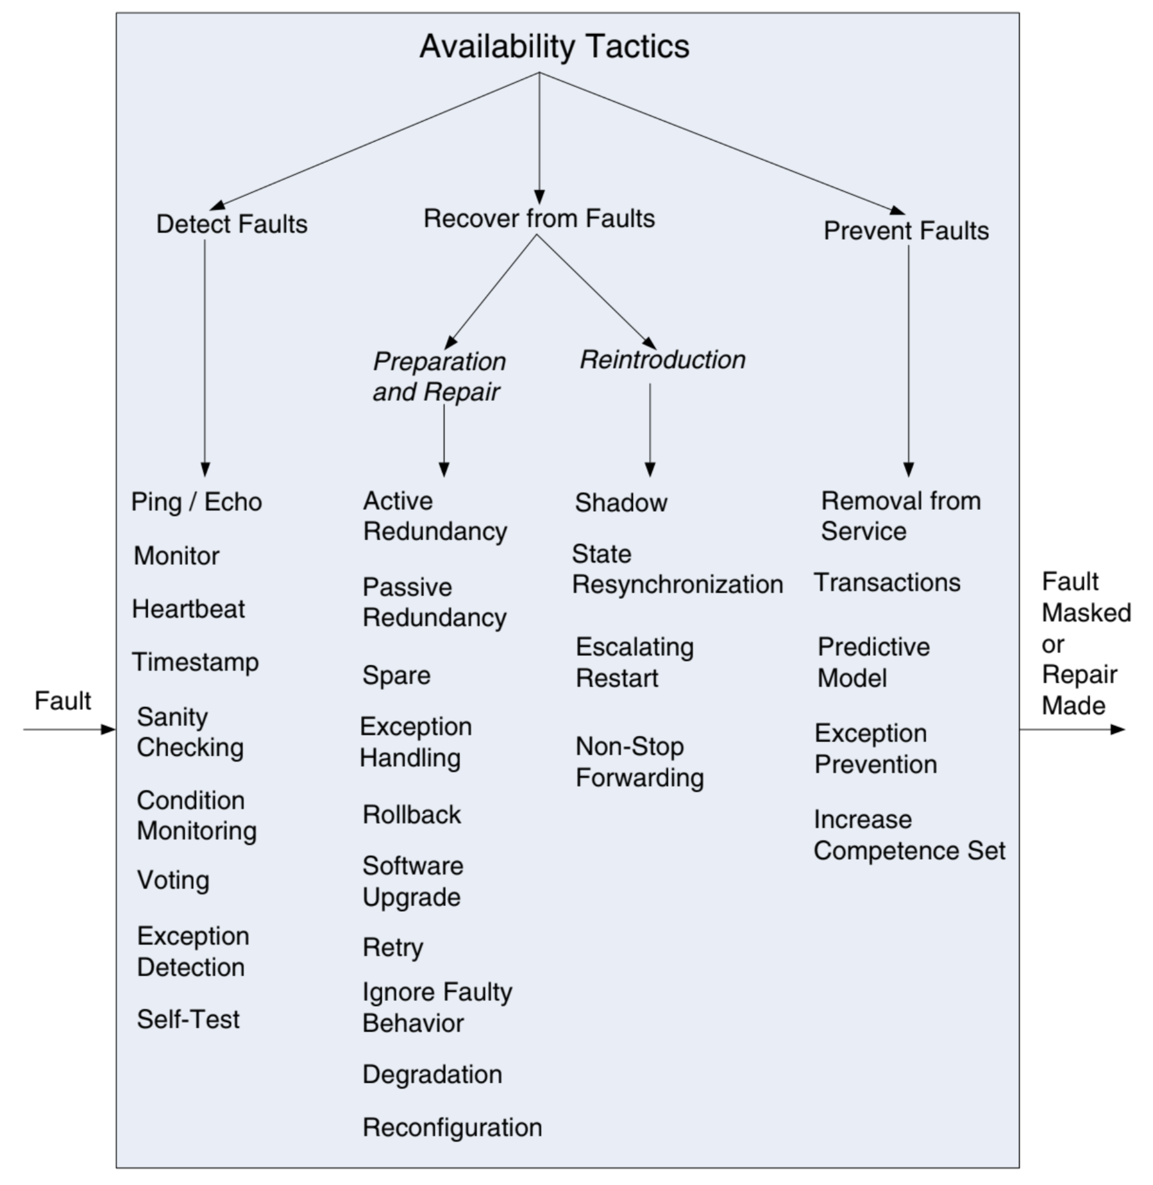
Availability Tactics
Detect Faults
Recover from faults
Preparation and repair
Reintroduction
Prevent Faults

Slide 7


5 9s availability may refers to
ⓘ Start presenting to display the poll results on this slide.
Notes:
📣 This is Slido interaction slide, please don't delete it. ✅ Click on 'Present with Slido' and the poll will launch automatically when you get to this slide.

Slide 8
?
Any Questions?

Slide 9
Homework:
Identify the availability tactics that will be part of your project.
Next Class: AI Strategy - Dr. Ram’s team
Contact: sumitk@iitj.ac.in

